Slide 1
Overview of Title IX and Your Responsibilities as an Athenian Academy employee

Slide 2
Training Objectives
KNOW
the federal regulations and Board policies governing sexual harassment.
Understand
your obligations under Title IX and Board policies.
Identify
what actions constitute sexual harassment.
Respond
Appropriately to reports or allegations of sexual harassment.

Slide 3
TITLE IX
“No person in the United States shall, on the basis of sex, be excluded from participation in, be denied the benefits of, or be subjected to discrimination under any education program or activity receiving Federal financial assistance.”

Slide 4
TITLE IX
§ 106.10 Scope. Discrimination on the basis of sex includes discrimination on the basis of sex stereotypes, sex characteristics, pregnancy or related conditions, sexual orientation, and gender identity.

Slide 5

Sexual Harassment Defined
Sexual Harassment: conduct on the basis of sex which satisfies one or more of the following three definitions:
  QUID PRO QUO An employee conditioning the provision of aid, benefit, or service of the School on an individual’s participation in unwelcome sexual conduct.
  For example, You do this for me, and I will give you this…

Slide 6
Sexual Harassment Defined
  HOSTILE ENVIRONMENT Unwelcome conduct determined by a reasonable person to be so severe, pervasive, and objectively offensive that it effectively denies a person equal access to the recipient’s education program or activity; or
  Any of the following:
    Sexual assault
    Dating violence
    Domestic violence
    Stalking

Slide 7
Types of Sexual Assault
Forcible Rape
Forcible Sodomy
Sexual Assault with an Object
Forcible Fondling (i.e., breasts, buttocks or groin)
Incest
Statutory Rape

Slide 8


Complainants and Respondents
Complainant: an individual who is alleged to be the victim of conduct that could constitute sexual harassment or discrimination.
May be a student, an applicant, employee or anyone attempting to access an educational program or activity.
Respondent: an individual alleged to have violated T IX’s prohibition of sexual harassment

Slide 9
Educational Program or Activity
Schools must address allegations of sexual harassment that occur in “the school’s education program or activity, against a person in the United States.”
  “Education program or activity” is broadly defined to include locations, events, or circumstances over which the school exercises substantial control.
  Examples include school field trips, school dances and sporting events.
  The school must have substantial control over both the respondent (i.e., the alleged harasser) and the context in which the sexual harassment occurs.

Slide 10

Duty to Report
Federal Title IX Regulations require schools to respond whenever any employee has notice of sexual harassment, including mere allegations of sexual harassment without delay.
All employees are required to report acts of sex discrimination, including sexual harassment to the School’s Title IX Coordinator.
All allegations of sexual harassment must be reported to the School’s Title IX Coordinator.
  Notifying law enforcement is not sufficient! Even when there is a law enforcement investigation, the school must follow its procedures outlined in board policy to comply with the TIX regulations.

Slide 11

You Have a Duty to Report All Allegations of Sexual Harassment
While many reports of sexual harassment may come to employees by witnessing instances first-hand, the duty to report also extends to information received second-hand.
The duty to report may even extend to rumors and gossip if the allegations are detailed enough to create NOTICE to the School.
If an incident of sexual harassment occurs and you are unsure of whether you need to report it, always seek the guidance of the School’s Title IX Coordinator and err on the side of reporting.

Slide 12

Guidance on When to Report
Allegations of sexual harassment against an administrator may be reported directly to the Title IX Coordinator.
Off-campus incidents may be within the duty to report under Title IX, so employees should report them and/or seek the direction of an administrator, supervisor, or Title IX Coordinator if they are unsure whether they need to report.

Slide 13

You Have a Responsibility
to Take Action
Whether or not a formal complaint of sexual harassment is filed, or a student asks the school site to act, the School must take steps to understand what occurred and to respond appropriately and in a timely manner.

Slide 14
While many employees have relationships of trust with students and other employees, it is not appropriate to promise someone that you will not report what they tell you regarding sexual harassment.
A school employee who fails to promptly report an incident of sexual harassment of which the school employee is aware, may be subject to a personnel investigation and disciplinary action, up to, and including termination.
Any person may report sexual harassment. They do not have to be the alleged victim of sexual harassment.
Reports of sexual harassment may be made in person, by mail, by telephone, or by electronic-mail, using the Title IX Coordinator’s contact information.
Please note that all Athenian Academy employees are mandatory reporters according to Federal Title IX regulations.
Failure to Report

Slide 15
Reports of Child Abuse
Pursuant to Florida law and Board Policy, any person, including teachers, administrators, support staff, and other school personnel, who knows, or has reasonable cause to suspect that a child or student has been abused, abandoned or neglected, subjected to inappropriate intimate interactions by adults or has become the victim of a known or suspected juvenile sexual offender, MUST report such knowledge or suspicion to the Florida Department of Children and Families.
  Call the hotline at 1(800) 96-ABUSE
For more information on mandatory reporting of child abuse and neglect, please refer to the employee handbook.

Slide 16
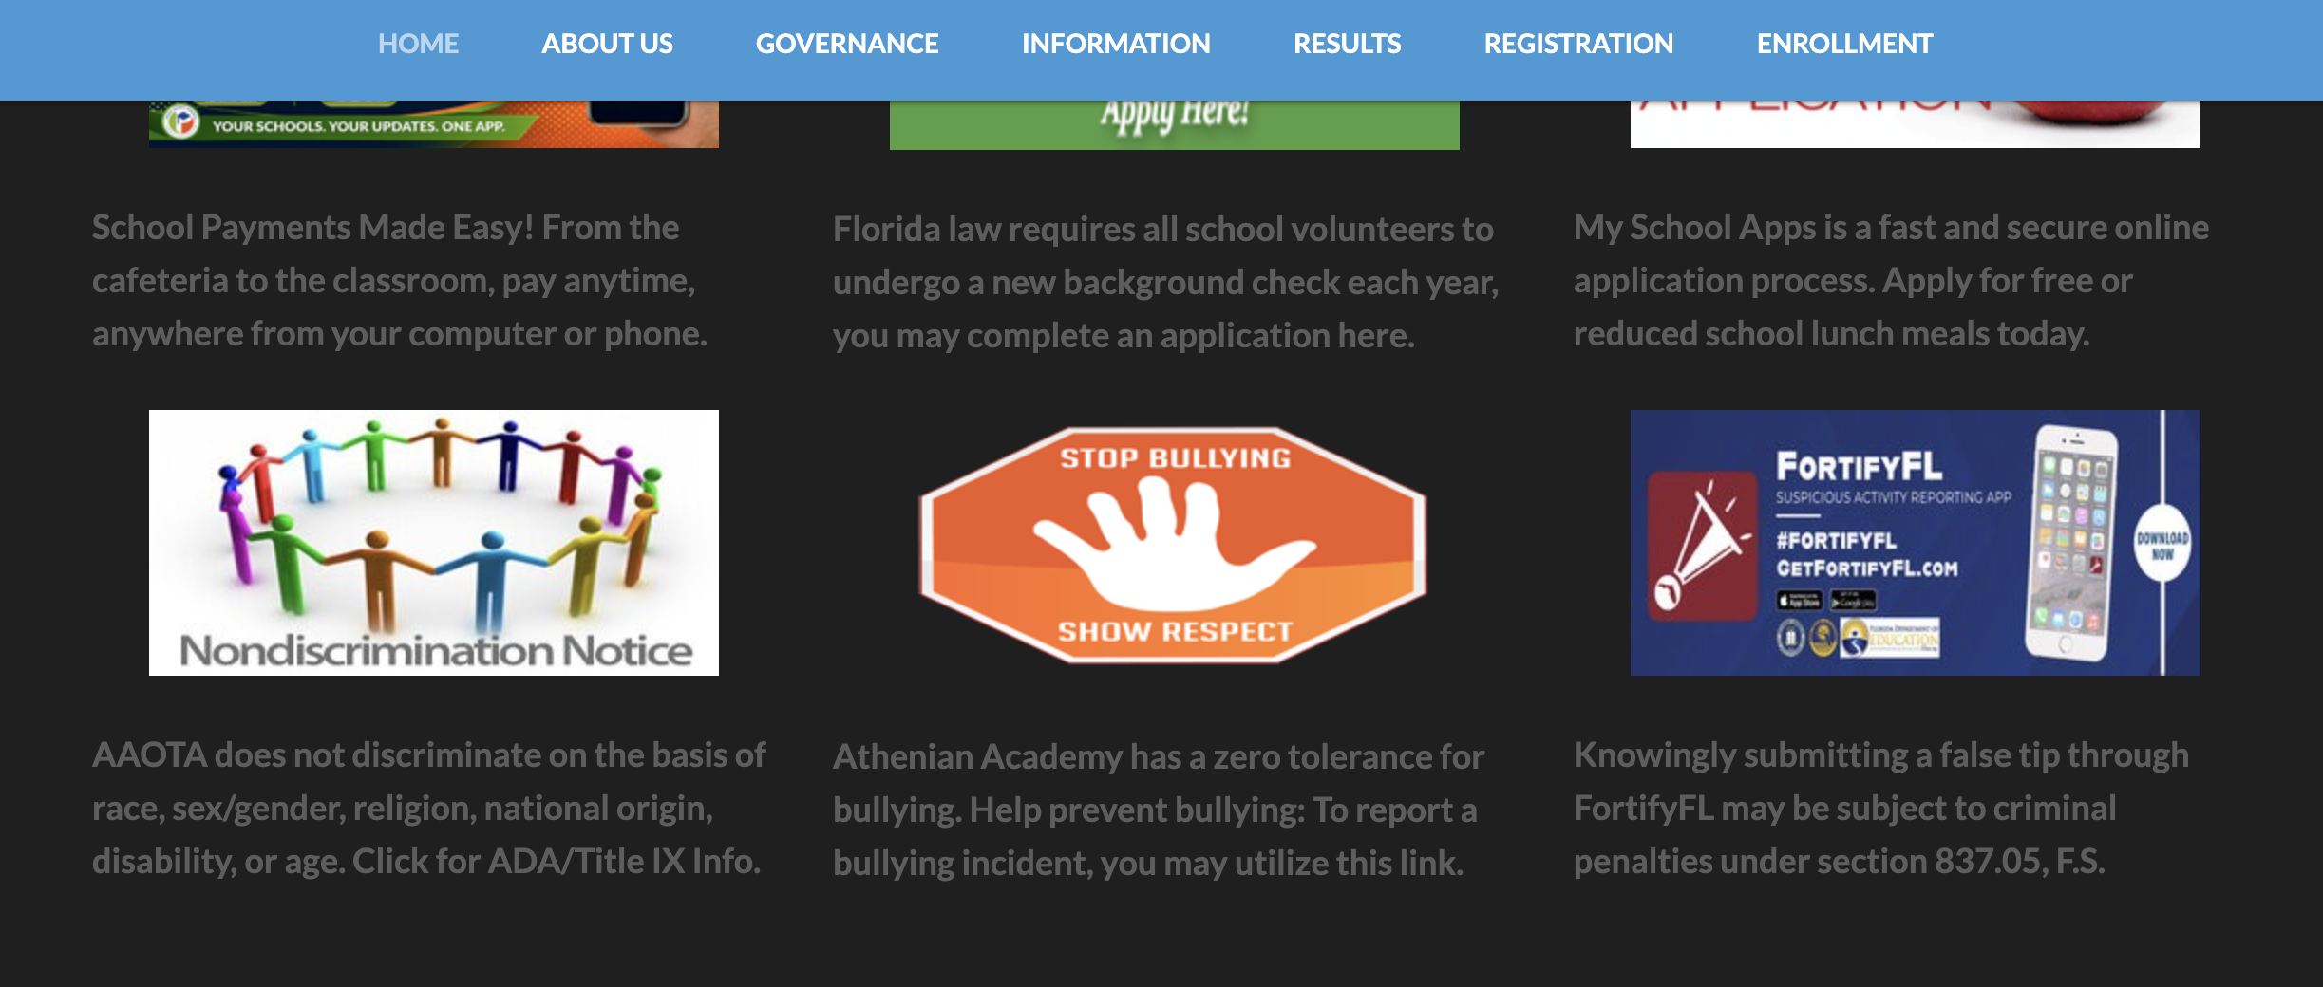
Role of the Title IX Coordinator
The School’s Title IX Coordinator’s role is to oversee the school’s efforts to investigate, STOP,
PREVENT, and REMEDY all forms of harassment, including sexual harassment within educational programs and activities.
School Title IX Coordinator Contact Information:
Evan Markowitz
Phone: 727-372-0200
Email: evan.markowitz@aaota.org
Website: Located in Legal Footer links https://www.aaota.org/nondiscrimination

Slide 17



If sexual harassment or sex-based discrimination is a maybe…
Notify your supervisor

Slide 18

Scenario 1
Ms. Blackwell, a custodian overheard two students Charles and Mark, discuss an incident when Mark’s girlfriend, Amy, slapped him and pulled his hair at a school football game during an argument.
Should Ms. Blackwell report this incident?

Slide 19
Scenario 1 Outcome
Yes. Ms. Blackwell should report this incident to her school administrator or the School’s Title IX Coordinator.
Ms. Blackwell has heard an allegation of sexual harassment under Title IX, specifically, allegations of dating violence.
Even though Ms. Blackwell is not a direct witness to the dating violence discussed between the two students, she is aware of an allegation and must report it.

Slide 20

Scenario 2
A teacher, Mr. Brown, witnessed a 6th-grade student from another class grab a female student’s breast while on a school bus during a field trip.
Should Mr. Brown report this incident?

Slide 21
Scenario 2 Outcome
Yes. Mr. Brown should report this incident to a school administrator or the Title IX Coordinator as it describes a possible sexual assault (forcible fondling) during an educational program or activity.

Slide 22

Scenario 3
A parent informs you that her son, Stanley Student, is being sent nude photos by a female student, Harriet Harasser, while he is trying to participate in his history class.
The parent reports that the photos are being sent every day and are very graphic in nature. The parent also tells you that Stanley is reluctant to go to this class because when Harriet sees him in class, she sends more shocking photos to get a visible reaction from Stanley during class.
Is this conduct that should be reported?

Slide 23

Scenario 3 Outcome
Yes. This conduct may constitute unwelcome conduct determined by a reasonable person to be so severe, pervasive, and objectively offensive that it effectively denies a person equal access to the recipient’s education program or activity (Hostile Environment)
This Photo by Unknown Author is licensed under CC BY-NC-ND

Slide 24

Scenario 4
You overhear, students discussing a social studies teacher, Ms. Alexandra Hamilton. The students state that if they give Ms. Hamilton their cell phone number and add her as a friend on Instagram, she gives them extra credit.
Is this conduct that should be reported?
This Photo by Unknown Author is licensed under CC BY

Slide 25
Scenario 4 Outcome
Most likely, yes. While this conduct may not be in and of itself sexual in nature, it may constitute “grooming behavior”, a process by which an offender draws a victim into a sexual relationship and maintains that relationship in secrecy.
Providing supportive measures as well as reiterating the importance of staff maintaining appropriate boundaries with students would be needed in this scenario.

Slide 26
Scenario 5
Deena works in the office of the maintenance department. She keeps her hair cut very short, dresses in men’s clothing, and does not wear makeup or jewelry.
Mr. Ellis, one of the plant managers in the department, calls her "Dean." He frequently comments that she should dress in a more “feminine” manner and that the men prefer to have pretty girls in the office. Mr. Ellis has also called Deena a derogatory term for “lesbian” on several occasions.
Is this conduct that should be reported?

Slide 27
Scenario 4 Outcome
Yes. This conduct may constitute sex-based discrimination.
Providing supportive measures as well as reiterating the importance of employees maintaining professional conversations would be appropriate in this scenario.

Slide 28

Contact Title IX Coordinator
Call: 727-372-0200
Email: evan.markowitz@aaota.org
Visit: https://www.aaota.org/nondiscrimination/

